Slide 1
“Can’t we just be friends?”
How we relate to each other: A two week mini series

Slide 2
Love Bank
Every single interaction with another human being:
  Make a Deposit
  Make a withdrawal
  Maintain our current level of love

Slide 3
Love bank Illustrated
Sled’s love bank
+100 points
+ 200 points
Rosetta’s love bank
+ 100 points
+ 200 points

Slide 4
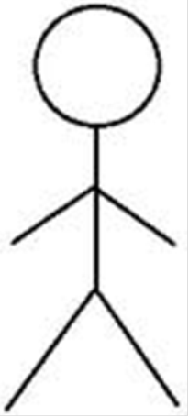
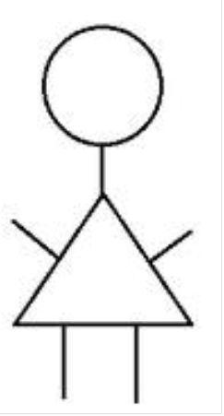
Love bank continued…
Sled’s love bank
-100 points
Beatrice’s love bank
+25 points

